Slide 1
C-based I/O functions clearerr()
#include <cstdio>
void clearerr(FILE *stream);
The clearerr( ) function resets (i.e., sets to zero) the error flag associated with the stream pointed to by stream.
The end-of-file indicator is also reset.
The error flags for each stream are initially set to zero by a successful call to fopen( ).
File errors can occur for a wide variety of reasons, many of which are system dependent.
The exact nature of the error can be determined by calling perror( ), which displays what error has occurred.

Slide 2
fclose()
#include <cstdio>
int fclose(FILE *stream);
The fclose( ) function closes the file associated with stream and flushes its buffer.
After an fclose( ), stream is no longer connected with the file, and any automatically allocated buffers are deallocated.
If fclose( ) is successful, zero is returned; otherwise EOF is returned.
Trying to close a file that has already been closed is an error.

Slide 3
feof()
#include <cstdio>
int feof(FILE *stream);
The feof( ) function checks the file position indicator to determine if the end of the file associated with stream has been reached.
A nonzero value is returned if the file position
indicator is at end-of-file; zero is returned otherwise.
Once the end of the file has been reached, subsequent read operations will return EOF until either rewind( ) is called or the file position indicator is moved using fseek( ).

Slide 4
ferror()
#include <cstdio>
int ferror(FILE *stream);
The ferror( ) function checks for a file error on the given stream.
A return value of zero indicates that no error has occurred, while a nonzero value means an error.
To determine the exact nature of the error, use the perror( ) function

Slide 5
fflush()
#include <cstdio>
int fflush(FILE *stream);
If stream is associated with a file opened for writing, a call to fflush( ) causes the contents of the output buffer to be physically written to the file. The file remains open.
A return value of zero indicates success; EOF indicates that a write error has occurred.
All buffers are automatically flushed upon normal termination of the program or when they are full. Also, closing a file flushes its buffer.

Slide 6
fgetc()
#include <cstdio>
int fgetc(FILE *stream);
The fgetc( ) function returns the next character from the input stream from the current position and increments the file position indicator.
The character is read as an unsigned char that is converted to an integer.
If the end of the file is reached, fgetc( ) returns EOF. However, since EOF is a valid
integer value, when working with binary files you must use feof( ) to check for the end of the file.

Slide 7
fgets()
#include <cstdio>
char *fgets(char *str, int num, FILE *stream);
The fgets( ) function reads up to num-1 characters from stream and places them into the character array pointed to by str.
Characters are read until either a newline or an EOF is received or until the specified limit is reached.
After the characters have been read, a null is placed in the array immediately after the last character read.
A newline character will be retained and will be part of the array pointed to by str.
If successful, fgets( ) returns str; a null pointer is returned upon failure.
If a read error occurs, the contents of the array pointed to by str are indeterminate.
Because a null pointer will be returned when either an error has occurred or when the end of the file is reached, you should use feof( ) or ferror( ) to determine what has actually happened.

Slide 8
fopen()
#include <cstdio>
FILE *fopen(const char *fname, const char *mode);
The fopen( ) function opens a file whose name is pointed to by fname and returns the stream that is associated with it.
The type of operations that will be allowed on the
file are defined by the value of mode.
If fopen( ) is successful in opening the specified file, a FILE pointer is returned.
If the file cannot be opened, a null pointer is returned.

Slide 9
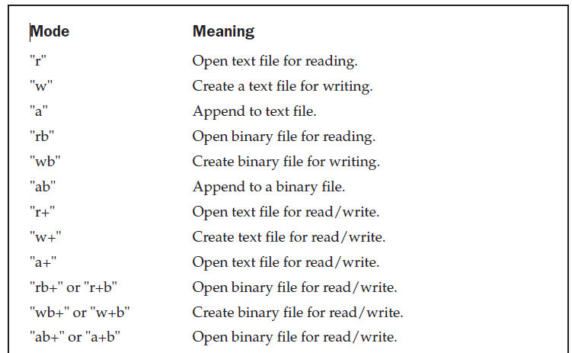

Slide 10
fprintf()
#include <cstdio>
int fprintf(FILE *stream, const char *format, ...);
The fprintf( ) function outputs the values of the arguments that comprise the argument list as specified in the format string to the stream pointed to by stream.
The return value is the number of characters actually printed. If an error occurs, a negative number is returned.

Slide 11
fputc()
#include <cstdio>
int fputc(int ch, FILE *stream);
The fputc( ) function writes the character ch to the specified stream at the current file position and then advances the file position indicator.
The value returned by fputc( ) is the value of the character written.
If an error occurs, EOF is returned.
For files opened for binary operations, an EOF may be a valid character, and the function ferror( ) will need to be used to determine whether an error has actually occurred.

Slide 12
fputs()
#include <cstdio>
int fputs(const char *str, FILE *stream);
The fputs( ) function writes the contents of the string pointed to by str to the specified stream.
The null terminator is not written.
The fputs( ) function returns nonnegative on success and EOF on failure.

Slide 13
fread()
#include <cstdio>
size_t fread(void *buf, size_t size, size_t count, FILE *stream);
The fread( ) function reads count number of objects, each object being size bytes in length, from the stream pointed to by stream and places them in the array pointed to by buf.
The file position indicator is advanced by the number of characters read.
The fread( ) function returns the number of items actually read. If fewer items are
read than are requested in the call, either an error has occurred or the end of the file has been reached.

Slide 14
fscanf()
#include <cstdio>
int fscanf(FILE *stream, const char *format, ...);
The fscanf( ) function works exactly like the scanf( ) function, except that it reads the information from the stream specified by stream instead of stdin.
The fscanf( ) function returns the number of arguments actually assigned values.
This number does not include skipped fields.

Slide 15
fseek()
#include <cstdio>
int fseek(FILE *stream, long offset, int origin);
The fseek( ) function sets the file position indicator associated with stream according to the values of offset and origin.
Its purpose is to support random-access I/O operations.
The offset is the number of bytes from origin to seek to.
The values for origin must be one of these macros (defined in <cstdio>).

Slide 16
Name Meaning
SEEK_SET Seek from start of file
SEEK_CUR Seek from current location
SEEK_END Seek from end of file
A return value of zero means that fseek( ) succeeded. A nonzero value indicates failure.
You may use fseek( ) to move the position indicator anywhere in the file, even beyond the end.
it is an error to attempt to set the position indicator
before the beginning of the file.

Slide 17
ftell()
#include <cstdio>
long ftell(FILE *stream);
The ftell( ) function returns the current value of the file position indicator for the specified stream.
The ftell( ) function returns −1 when an error occurs.

Slide 18
fwrite()
#include <cstdio>
size_t fwrite(const void *buf, size_t size, size_t count, FILE *stream);
The fwrite( ) function writes count number of objects, each object being size bytes in length, to the stream pointed to by stream from the character array pointed to by buf.
The file position indicator is advanced by the number of characters written.
The fwrite( ) function returns the number of items actually written, which, if thefunction is successful, will equal the number requested.
If fewer items are written than are requested, an error has occurred.

Slide 19
getchar()
#include <cstdio>
int getchar(void);
The getchar( ) function returns the next character from stdin.
The character is read as an unsigned char that is converted to an integer.
If the end of the file is reached, getchar( ) returns EOF.
If getchar( ) encounters an error, EOF is also returned

Slide 20
gets()
#include <cstdio>
char *gets(char *str);
The gets( ) function reads characters from stdin and places them into the character array pointed to by str.
Characters are read until a newline or an EOF is received.
The newline character is not made part of the string; instead, it is translated into a null to terminate the string.
If successful, gets( ) returns str; a null pointer is returned upon failure.
There is no way to limit the number of characters that gets( ) will read, and it is possible for the array pointed to by str to be overrun. Thus, gets( ) is inherently
dangerous.

Slide 21
putchar()
#include <cstdio>
int putchar(int ch);
The putchar( ) function writes the character contained in the least significant byte of ch to stdout.
It is functionally equivalent to putc(ch, stdout).
The putchar( ) function returns the character written on success or EOF if an error occurs.

Slide 22
puts()
#include <cstdio>
int puts(const char *str);
The puts( ) function writes the string pointed to by str to the standard output device.
The null terminator is translated to a newline.
The puts( ) function returns a nonnegative value if successful and an EOF upon failure.

Slide 23
remove()
#include <cstdio>
int remove(const char *fname);
The remove( ) function erases the file specified by fname.
It returns zero if the file was successfully deleted and nonzero if an error occurred.

Slide 24
rename()
#include <cstdio>
int rename(const char *oldfname, const char *newfname);
The rename( ) function changes the name of the file specified by oldfname to newfname.
The newfname must not match any existing directory entry.
The rename( ) function returns zero if successful and nonzero if an error has occurred.

Slide 25
rewind()
#include <cstdio>
void rewind(FILE *stream);
The rewind( ) function moves the file position indicator to the start of the specified stream.
It also clears the end-of-file and error flags associated with stream. It has no return value.

